Slide 1

C3 at Our Lady of Perpetual Help School

Slide 2

Happy 12th Birthday Google!

Slide 3
Commitment
“Our mission is to enable our school community to achieve enhanced teaching, learning and communication through technology integration.”

Slide 4
Tools for success
Student computers in the classrooms
Wireless laptops
Projectors in every classroom
Moodle Learning Management System
Middle School Student email accounts
Discovery Education Streaming
Renaissance Learning products
Kurzweil educational system and more…

Slide 5
Responsibility to our students
Educate them in the areas of:
  Cyber Ethics
  Cyber Security
  Cyber Safety

Slide 6
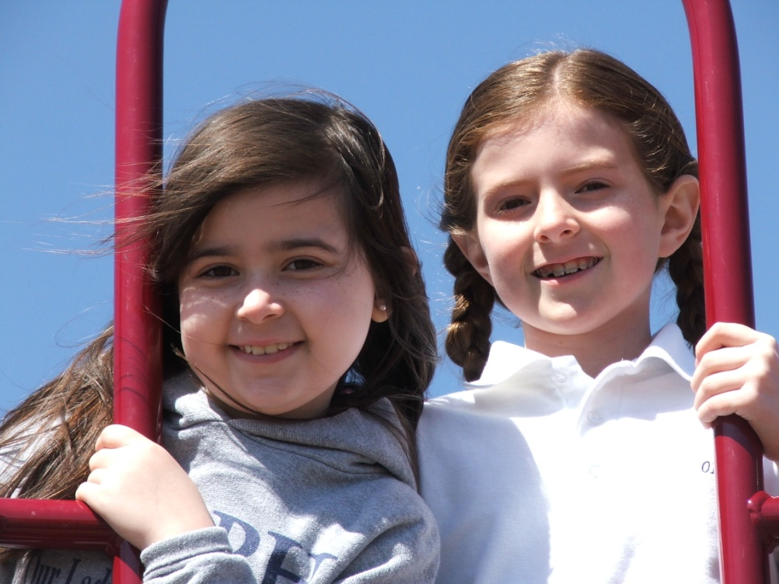
2010 C3 Grant
New opportunities to educate our students, faculty and parent community in an engaging effective manner.

Slide 7

Middle School student created video contest
  All original content addressing C3s
  Videos will be targeting students in Third to Fifth Grade
  Videos and awards will be presented at school-wide C3 Fair

Slide 8
OLPH C3 Fair
Student and parent community
Video award presentation
Parent informational session
C3 at OLPH mouse pads as “giveaways” to all parent attendees.

Slide 9

Parent educational video
Creation of a parent educational video to be delivered through our website.

Slide 10
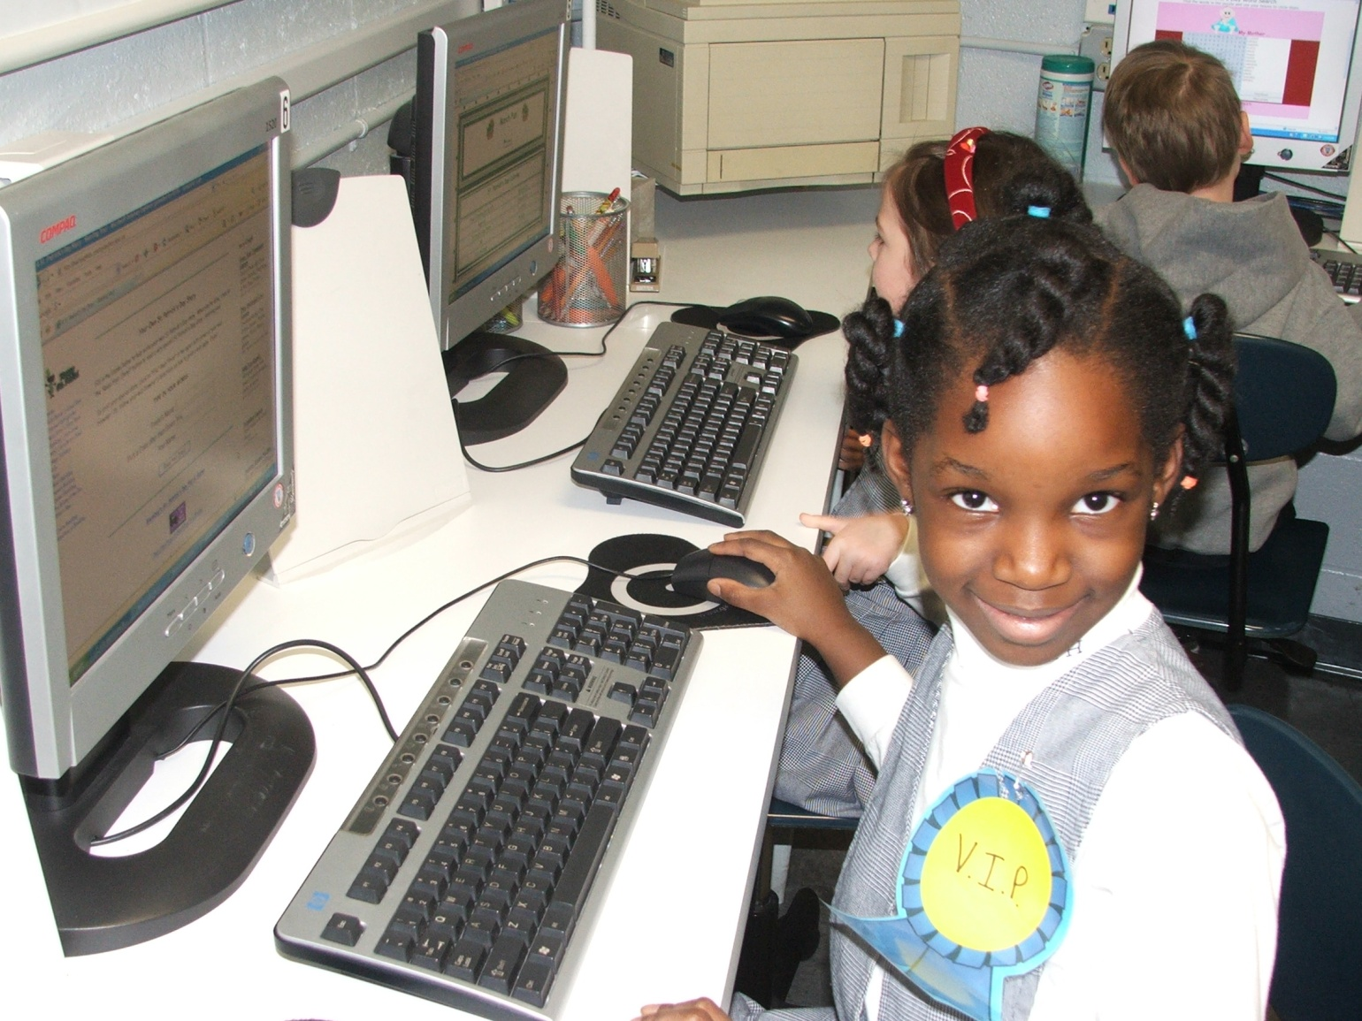
Thank you for the opportunity!

Slide 11
Zulma Whiteford
zwhiteford@olphschool.org
www.olphschool.org

