Slide 1
USNa Core Cyber Curriculum
MIDN Zac Dannelly

Slide 2
History
May 2009: President's 60-day Cyberspace Policy Review
  "expand and train the workforce”
May 2010: The Ad Hoc Committee on Cyber Security Curriculum Options
August 22, 2011: First day of class; SI110 begins.

Slide 3
Mission Statement
Educate each Midshipman about:
Cyber infrastructure and embedded systems
Inherent cyber vulnerabilities and threats
Appropriate defensive security procedures
Thereby enabling them to make principled decisions regarding the potential benefits, consequences, and risks.

Slide 4
Structure
Introduction to Cyber Security – Technical Foundations
Semester long (16-week) 3 credit course
More than 1,000 students per year
  Mandatory for graduation across all majors
Precursor to EC 310 Applications of Cyber Engineering

Slide 5
Outline
Cyber Operations
Forensics: Digital Forensics
Reconnaissance
Attack
Defense
Case Studies
Cyber Security Tools
Encryption
Hashing & Passwords
Cryptography in Practice
Firewalls
Steganography
Cyber Battlefield
Introduction to Cyber Security
Digital Data
Hardware
Operating Systems
Web
Networking

Slide 6
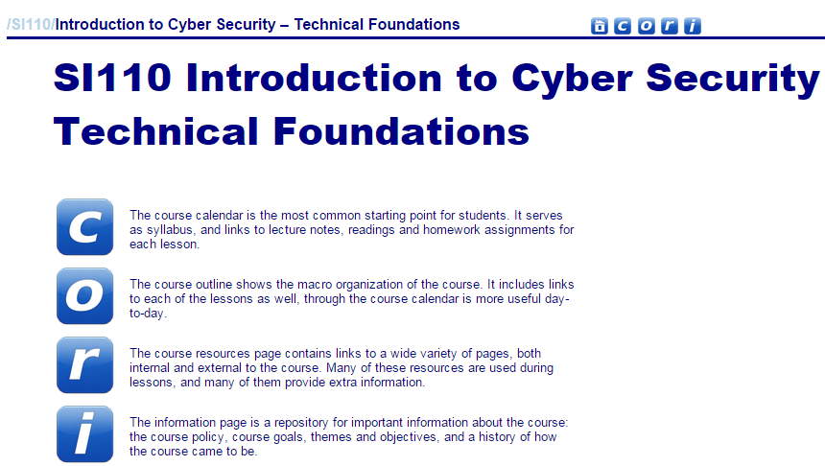
Landing Page https://www.usna.edu/CS/si110/index.html

Slide 7
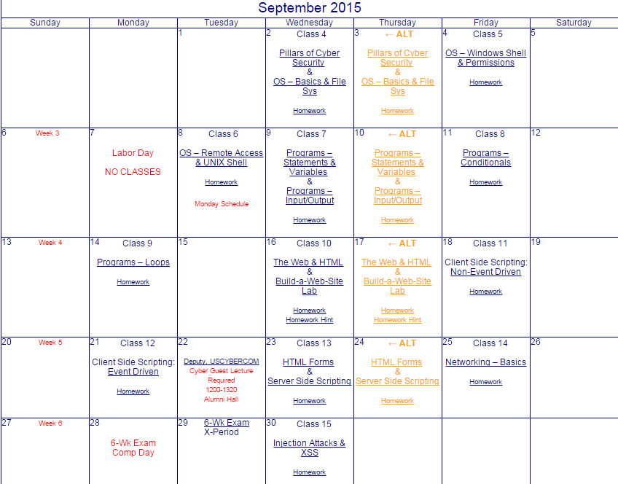
Calendar
/calendar.html

Slide 8
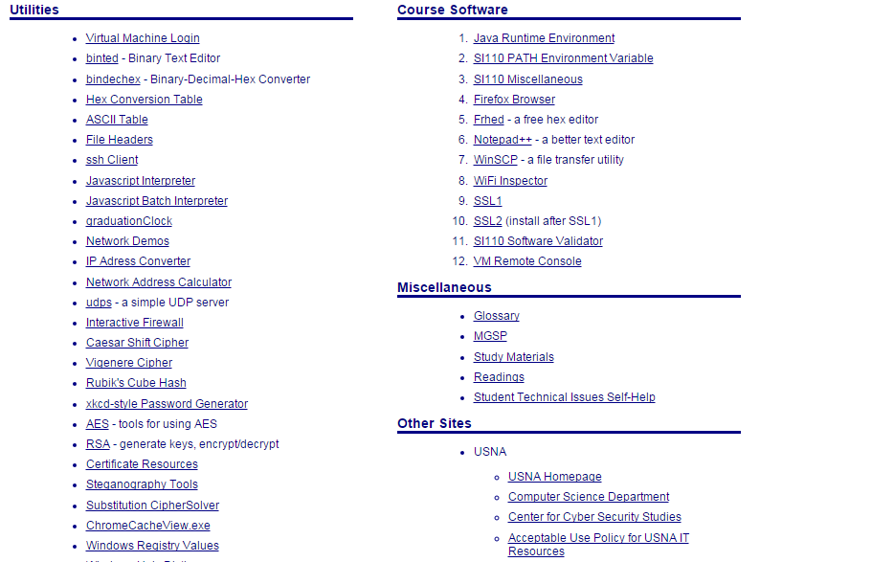
Resources
/resources/index.html

Slide 9
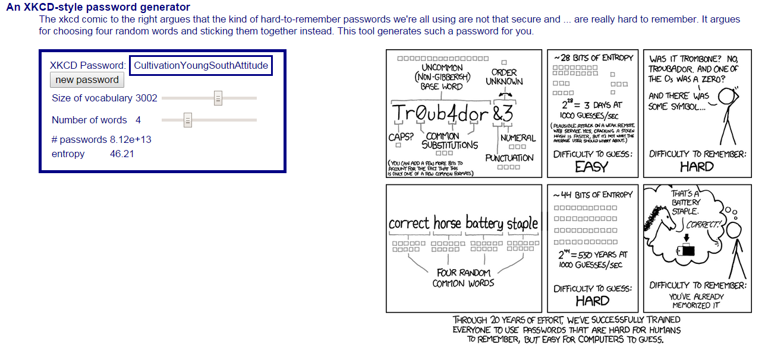
Example of Resources
An XKCD-style password generator:
The hard-to-remember passwords we're all using are not that secure and hard to remember.
Choose four random words and sticking them together instead.
This tool generates such a password for you.

Slide 10
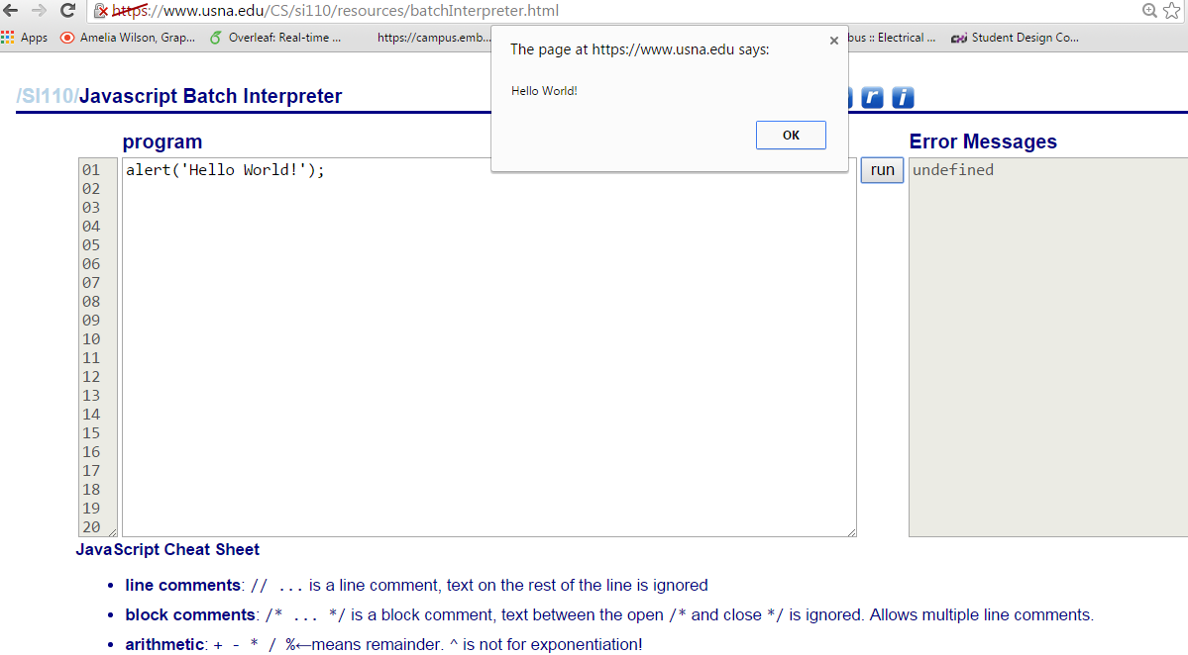
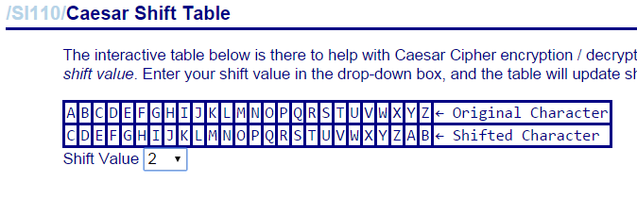
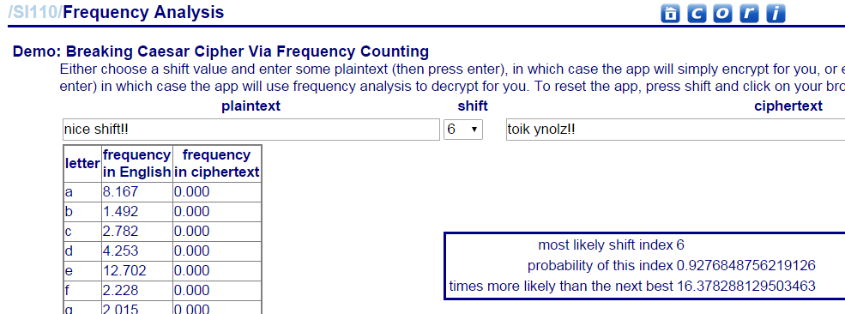

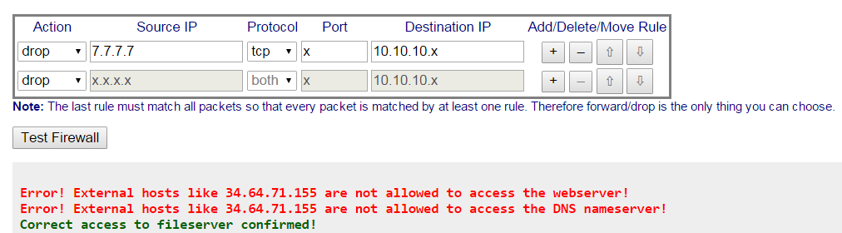
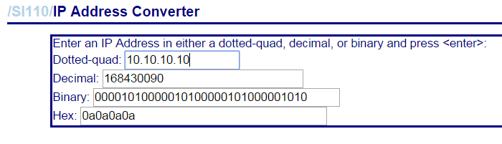
More Resources

Slide 11


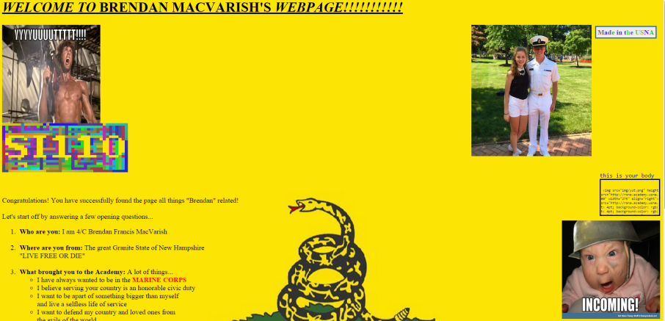
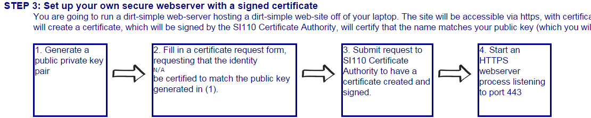


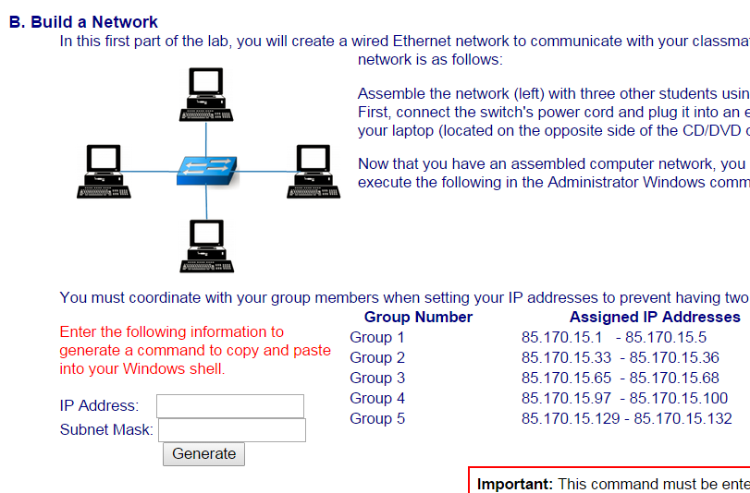
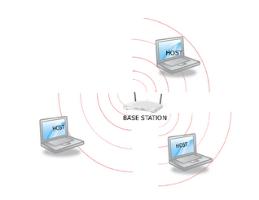
Labs

Slide 12

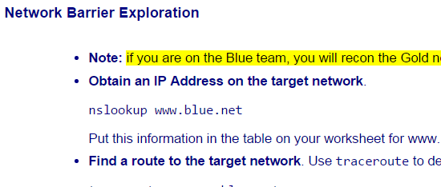
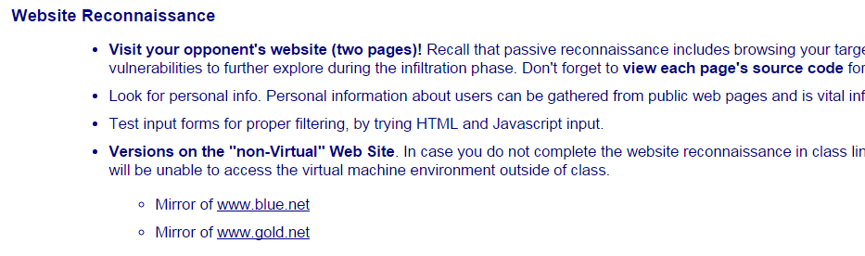
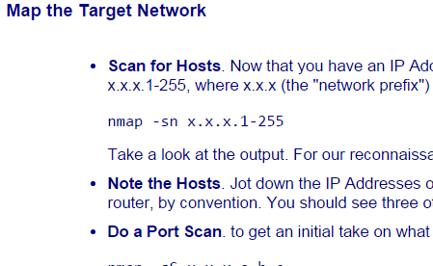
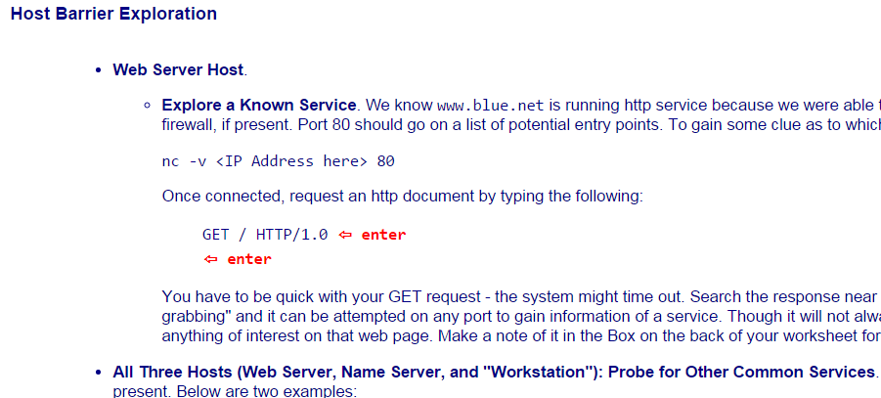
Network Recon Lab

Slide 13
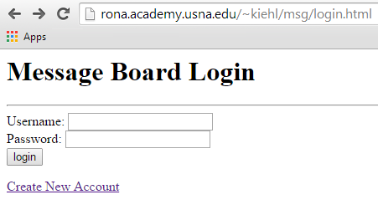
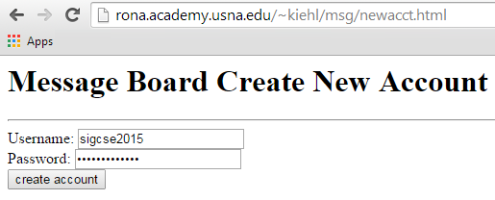
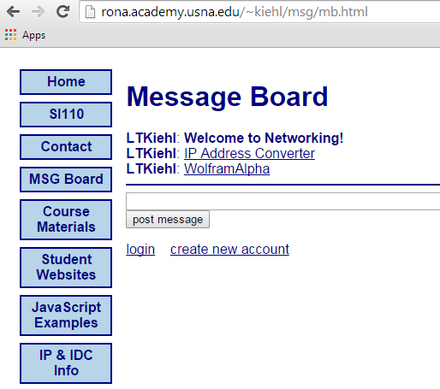
Message Board
CSS and webpage design is left up to instructor
Notes:
Looks really simple but mimiks a real sit that students understand.
This is a teaching tool to show potential vulnerability. Pedigocial tool not a produciton system.

Slide 14
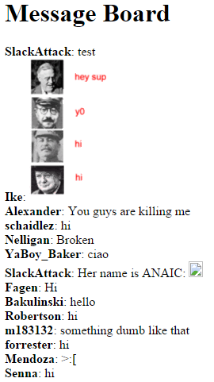

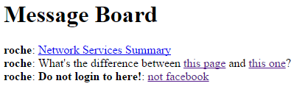
Advantages
Hands-On
Collaborative
Adaptive

Slide 15
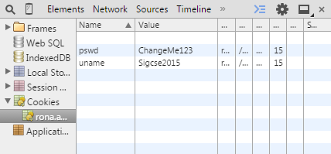
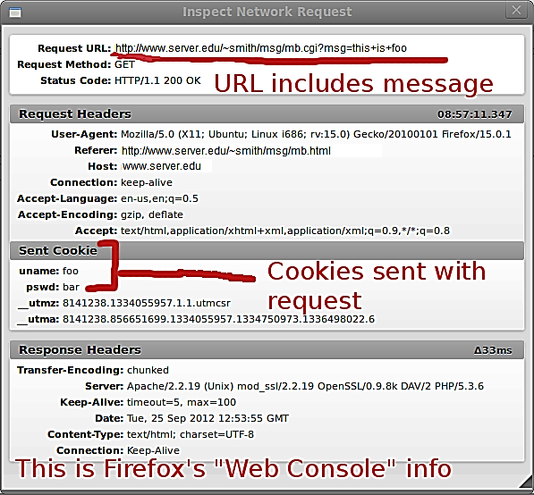
AUTHENTICATION & COOKIES
“The omission of password rules provides us with a good teaching opportunity to discuss the utility of such password rules: length of password, use of special symbols, uppercase letters, characters different from last password, and so on. ”
--------------------------------------------
“Users do not want to have to enter credentials to the browser each time that they make a request to a web server. “

Slide 16
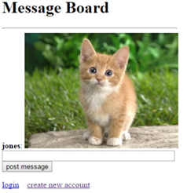
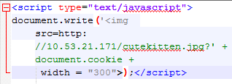

Injection attacks
“The instructor then begins announcing the passwords for every student by reading the webserver log for the server running on the instructor computer, demonstrating another weakness in authentication.”
--------------------------------------------------------------
“To end the lab, the instructor discusses the importance of sanitizing inputs and how to accomplish this task by escaping the symbols used to denote HTML tags, the < and > symbols. “
Notes:
What is type is posted >> I can post html…what will be posted typed or interpreted = later
Logical extension…java, pitcures, code ect. Make it do somehting. Teach programming and show absence of security features.
Rickroll..

Slide 17

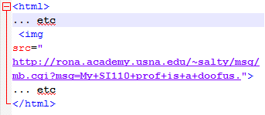
Phishing Attacks
“The professor sends an email with an enticing HTML attachment to an unsuspecting student, or to all students in the section. When a student opens the attachment, the student’s message-board login credentials are used to post a message to the message board. For example, a message is posted as follows: Student: My professor is a real doofus!”

Slide 18
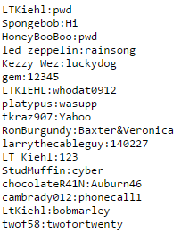



Passwords
Students look at code to make website and answer:
“Is there a file mentioned within the mb.cgi script that might be of interest?”
Case Study
rockyou.com break yielded 40 million user passwords that were stored all in an accessible plaintext file

Slide 19
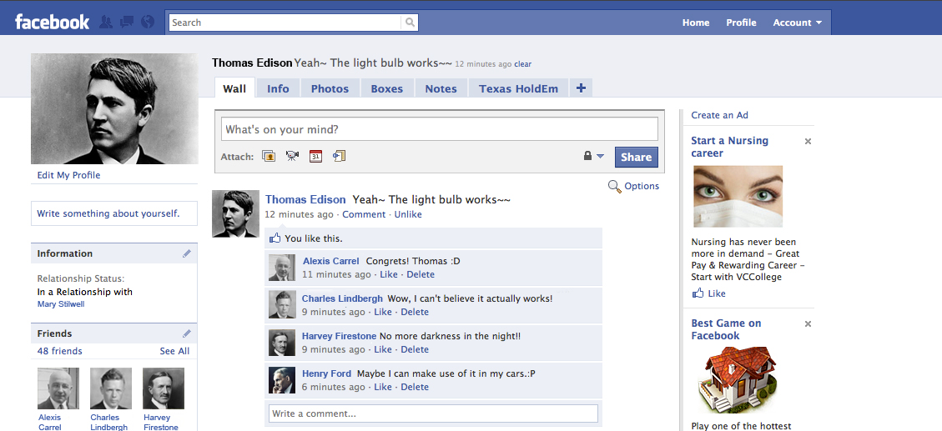
Relatability
USERS/PASSWORDS AND AUTHENTICATION
INJECTION ATTACKS AND CROSS_SITE SCRIPTING

Slide 20
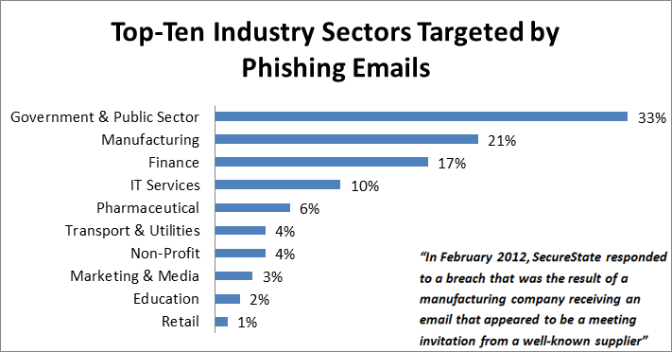
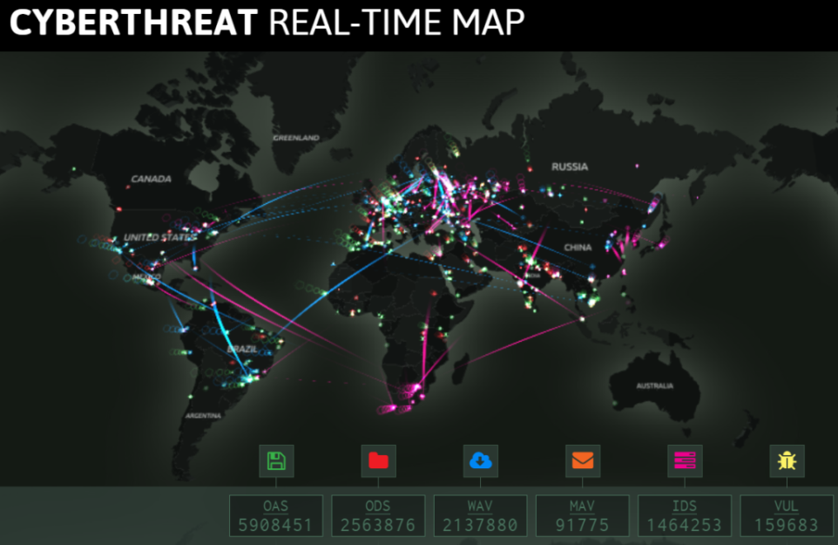
Useful
“There is no exaggerating our dependence on DoD’s information networks for command and control of our forces, the intelligence and logistics on which they depend, and the weapons technologies we develop and field.”
- 2010 Quadrennial Defense Review

Slide 21
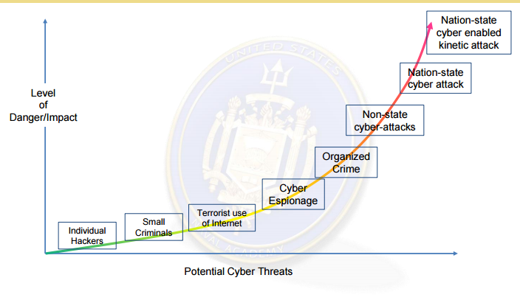
Necessary

Slide 22
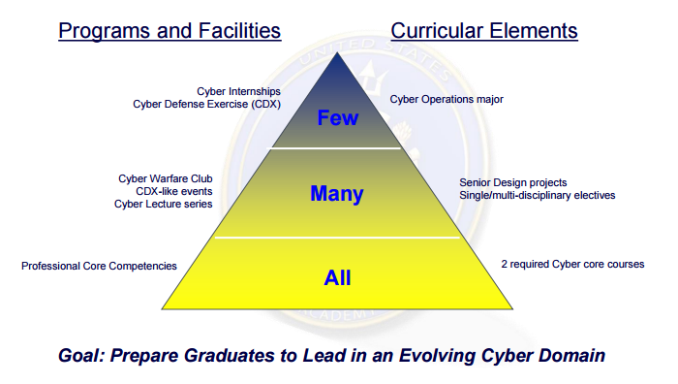
Professionalization

Slide 23
Contact
CAPT Paul J. Tortora, USN (ret.)
Director, Center for Cyber Security Studies
117 Decatur Ave, Leahy Hall, Room 304
United States Naval Academy
Annapolis Md 21402
410-293-0933
tortora@usna.edu
MIDN 1/C Zac Dannelly | dannellyz@gmail.com

Slide 24
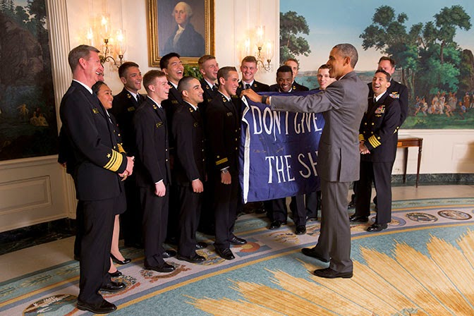
Go Navy! Beat Air Force!
…Again

Slide 25
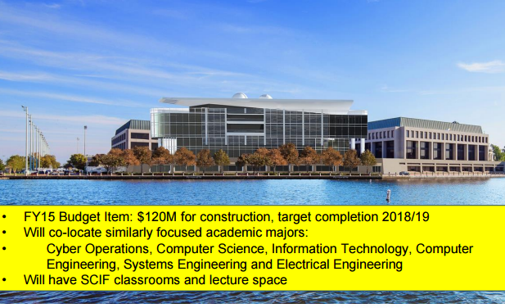
Looking Ahead

