Slide 1
Building the Cybersecurity Workforce
Benjamin Scribner
Department of Homeland Security (DHS)
National Cybersecurity Education & Awareness Branch (CE&A)
October 1, 2015
C3 & National K-12 Cybersecurity Education Conference

Slide 2

Cybersecurity: Why it Matters
Notes:
You don’t have to look very far to appreciate the benefits and convenience of technology. Never before have we been so connected across the globe. Most of us can check messages (which you hopefully aren’t doing right now!), socialize with friends, purchase merchandise, and conduct business from devices slipped into our pocket.
But with this convenience comes threats we haven’t experienced in previous generations. Whether we like it or not, your personal data is somewhere in cyberspace if you use online technology. Sensitive data for industry and government also exists in the cyber world. This data is valuable and criminals know it. Unfortunately, many have been successful in obtaining it.
<SPEAKER: Choose 2 – 3 examples to present that fit audience receiving presentation>
Global cyber-crime likely cost individuals, companies and governments between $375 billion and $575 billion in 2013, according to a recent report published by the Center for Strategic and International Studies.
According to the HP 2014 Cost of Cyber Crime Study, the average annualized cost of cybercrime for the 59 representative participating US companies incurred per organization was $12.7 million (up from $7.2 million in 2013), with the maximum being $61 million (up from $58 million in 2013).
The HP study also notes that smaller organizations incur a significantly higher per capita cost than larger ones ($1,513 versus $517).
Nearly one in five Americans (18%) has been the victim of a cybercrime (2011 NCSA/McAfee Internet Home Users Survey.
<SPEAKER: Choose 2 – 3 examples to present that fit audience receiving presentation>
Cyber crime affects all segments of our population. For example:
Critical Infrastructure
Increased attacks: Cyber attacks have steadily grown in number since 2009 and Intel and McAfee predict that they will absolutely continue to increase (source: The Aspen Institute/McAfee/Intel Critical Infrastructure Readiness Report)
Incidents reported to DHS ICS-CERT in 2013-14: Attacks against the Energy sector represented over 56 percent of all incidents reported to DHS’ Industrial Control Systems Cyber Emergency Response Team (ICS-CERT). (source: https://ics-cert.us-cert.gov/sites/default/files/documents/Year_In_Review_FY2013_Final.pdf) – this is a trend which continued 2014, with the manufacturing sector coming in a close second in 2014. (source: https://ics-cert.us-cert.gov/sites/default/files/documents/Year_in_Review_FY2014_Final.pdf)
Serious/Deadly Cyber Attacks Believed to be Likely Soon: In a recent report, American respondents, despite confidence in defenses, rated a serious cyberattack affecting critical services and causing loss of life as highly likely within the next three years. Especially members of the transportation and energy sectors predicted such an attack is extremely likely. (source: Critical Infrastructure Readiness Report by The Aspen Institute/McAfee/Intel - http://www.mcafee.com/us/resources/reports/rp-aspen-holding-line-cyberthreats.pdf)
National Security
Attacks against our federal government happen every day
The US Navy receives 110,000 cyber attacks every hour, or more than 30 every second (according to HP)
The Pentagon reports up to 10 million cyber attacks every day
The Nuclear Security Enterprise also receives up to 10 million cyber attacks every day
Economic Stability
In 2013, federal agents notified more than 3,000 companies that there computer systems have been hacked.
In 2014, eBay revealed that hackers had managed to steal personal records of 233 million users. Usernames, passwords, phone numbers and physical addresses were compromised.
J.P. Morgan said contact information for about 76 million households and about 7 million small businesses was compromised in a cyber attack. That includes names, email addresses, phone numbers and addresses but not financial information, such as passwords, dates of birth, social security numbers or account numbers.
Cyber criminals reportedly used malware to compromise the credit card information for roughly 56 million shoppers in Home Depot’s 2,000 U.S. and Canadian outlets.
Between July and October 2013, the credit card information of 350,000 Neiman Marcus customers was stolen, and more than 9,000 of the credit cards have been used fraudulently since the attack.
A staggering 43% of companies have experienced a data breach in the past year, an annual study from the Ponemon Institute on data breach preparedness finds.
Personal Safety
In 2012, 31% of all identity theft complaints received by the Federal Trade Commission were filed by young adults.
Cyber crimes victims per year are estimated at 556 million; there are 1.5 million victims per day and 18 per second
More than 600,000 Facebook accounts are compromised every day.
Organizations in defense, financial services and energy and utilities suffer the highest cybercrime costs. However, no industry is immune to cyber threats. It is a prevalent issue for small and large business, universities, and governments at all levels, across all types of sectors.
Who pays for these cyber crimes or protection against future cyber crimes? You do.
Retailers pass the cost of protecting against cyber threats to consumers, resulting in higher prices.
Credit Card Providers cover costs of cyber attacks through higher interest rates and user fees, to the tune of as much as 7% per year.
Up to $140 billion dollars in losses per year in the U.S alone could result in the increase of taxes, direct costs, fees, rates, productive time losses and prices among other hidden expenses.
The further effect of these $140 billion in losses is an estimated 500,000 jobs per year that are lost by workers.

Slide 3


We Need to Strengthen our Cyber Defense Corp
Clearly defined cybersecurity roles
Clear, specific, & realistic job requirements
Standardized skills & training
Notes:
SPEAK ABOUT ITEMS BELOW AFTER DISCUSSING BULLETS ON SLIDE, TO TRANSITION TO WORKFORCE FRAMEWORK SLIDES COMING NEXT.
C³ Voluntary Program & NIST Framework: The Critical Infrastructure Cyber Community C³ (pronounced “C Cubed”) Voluntary Program is the coordination point within the Federal Government for critical infrastructure owners and operators interested in improving their cyber risk management processes. The C³ Voluntary Program aims to:
Support industry in increasing its cyber resilience;
Encourage organizations to manage cybersecurity as part of an all hazards approach to enterprise risk management.
Increase awareness and use of the NIST Framework (C³ Voluntary Program works with the 16 critical infrastructure sectors to develop sector-specific guidance, as needed, for using the Framework.)
Key difference between NIST Framework and Workforce Framework: While the NIST Cybersecurity Framework focuses on technical standards, guidelines, and practices to promote the protection of critical infrastructure, the National Cybersecurity Workforce Framework focuses on defining and standardizing how we organize the cybersecurity workforce.
Importance of Critical Infrastructure: Cyber resilience measures designed primarily for critical infrastructure companies are predicted to become the norm for all industries (source: Kroll 2014 Cyber Security Forecast - http://www.kroll.com/media/pdf/reports/131204_cyber_predictions.pdf)

Slide 4
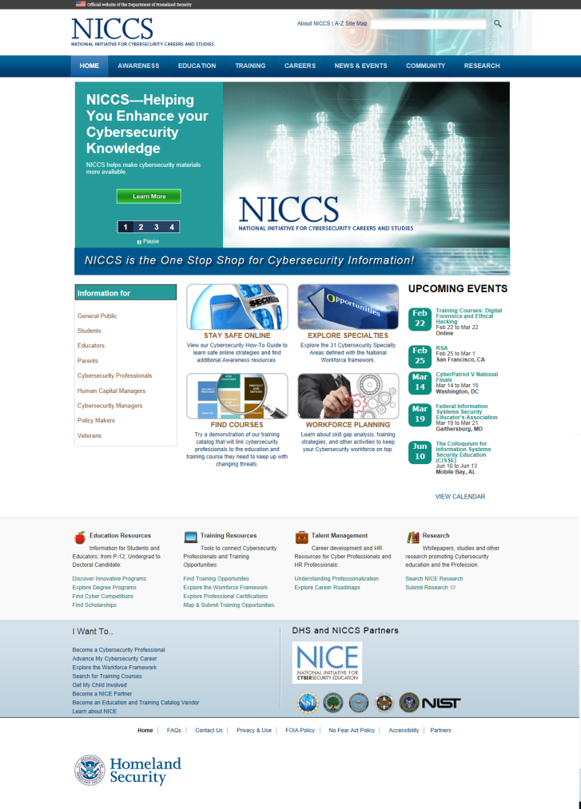
NICCS™ Website
The Nation’s One Stop Shop for Cybersecurity Careers and Studies!
28,000+ visitors per month
2,000+ training courses mapped to
the National Cybersecurity Workforce Framework
100+ links to cybersecurity resources
15+ tools for managers
10+ monthly events
10+ links to customized job searches
…and more coming soon!
www.niccs.us-cert.gov
Notes:
NICCS is the one-stop-shop for cybersecurity careers and studies – it takes key resources developed by DHS and NICE, and makes them available to the public
NICCS has an active user base that comes to access up-to-date information ranging from cybersecurity education and online safety, to workforce development and career resources – it is visited by nearly 30,000 people monthly
DHS also continues to build the NICCS Cybersecurity Training Catalog, which is the nation’s largest searchable repository of cybersecurity training, with access to more than 2,000 cybersecurity courses
NICCS also provides useful resources such as tools for managers, a national cybersecurity events calendar, and links to prepopulated cybersecurity job search inquiries on popular job search engines

Slide 5
















































The Power of Public-Private Partnerships
Government
Education
Industry
Notes:
The Workforce Framework is currently being used by multiple organizations to strengthen the cybersecurity workforce.
GOVERNMENT:
DOL Cybersecurity Competency Model: The Department of Labor (DOL) Employment & Training Administration (ETA) leveraged the Workforce Framework to develop its cybersecurity competency model. (A competency model is a collection of competencies that, together, define successful performance in a particular work setting.) The DOL cybersecurity competency model incorporates the Workforce Framework’s knowledge, skills, and abilities (KSAs) in an unduplicated form. The DOL competency model is a companion piece to the Workforce Framework.
Other competency models: Other federal agencies (such as at the VA and DHS) have started making competency models based on the Framework. These describe what cybersecurity workers do, and how they do it.
The Department of Defense is adapting a version of the workforce Framework to use in defining and developing their cybersecurity workforce.
The Workforce Framework is also recommended for organizations with needs for only specific cybersecurity duties. The Federal Chief Information Officers Council (CIOC) developed 13 roles to demonstrate this application (for example: Systems Operations Professional, Data Administrator, and Computer Network Defense Specialist).
Office of Personnel Management (OPM) Data Elements: OPM requires Federal agencies use the Workforce Framework. The July 8, 2013 OPM Data Element Memo requires US federal departments and agencies to track cybersecurity positions using the Workforce Framework.
Submit to Enterprise Human Resources Integrated (EHRI) data warehouse
2210 and 0334 personnel
100% by the end of 2014
The federal government is an important proving ground
The National Security Agency (NSA) and the Department of Homeland Security (DHS) jointly sponsor the National Centers of Academic Excellence (CAE).
The goal of CAE is to reduce vulnerability in our national information infrastructure by promoting higher education and research, and producing a growing pipeline of professionals with information assurance expertise in various disciplines.
There are approximately 200 centers nationwide, and graduates often develop into cybersecurity experts who help to protect national security information systems, commercial networks, and critical information infrastructure in the private and public sectors.
The CAE Knowledge Units are mapped to the Workforce Framework – we will discuss these in greater detail shortly.
Focus Group/Validation Session organizations that provided input to the Workforce Framework: FBI, USDA, HHS.
EDUCATION:
George Washington University and the National CyberWatch Center have mapped the Workforce Framework’s knowledge, skills, and abilities to CAE Knowledge Units, which will help align institutional programs and what students will learn.
Focus Group/Validation Session organizations that provided input to the Workforce Framework: Johns Hopkins, Virginia Tech, University of Maryland, National Defense University, San Jose State University, California State University, Georgia State University, Daytona State College, Montgomery College, Columbia University, Eastern Michigan University, County College of Morris, North Dakota State Univ, Alfred State, Champlain College.
INDUSTRY:
Focus Group/Validation Session organizations that provided input to the Workforce Framework: MITRE, PWC, Suntiva, Northrop Grummann, Secure Decisions, CISCO, GIAC, MAD Security, Phoenix Technology Solutions, Avaya, John Deere, Ashburn Cybersecurity, Deloitte, SRA, Electrosoft, Verizon, Discover Financial Services.

Slide 6
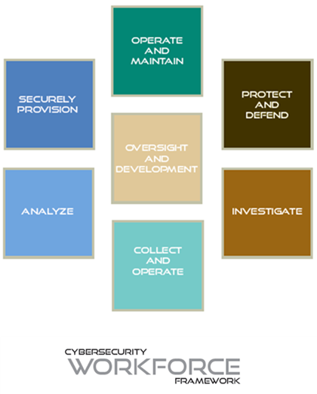
The Foundation for our Nation’s Cyber Workforce
The National Cybersecurity Workforce Framework
7 Categories, 30+ Specialty Areas
Baselines knowledge, skills, and abilities & tasks
Support for strategic workforce development
Notes:
The National Cybersecurity Workforce Framework (Workforce Framework) is a national resource that categorizes, organizes, and describes cybersecurity work.
It provide educators, students, employers, employees, training providers and policy makers with a national standard for organizing the way we define and talk about cybersecurity work, and what is required to do that work.
It identifies the tasks (or activities) performed to carry out cybersecurity work across over 30 Specialty Areas, as well as the requisite knowledge skills, and abilities.
As more organizations align their workforce development efforts the Workforce Framework, our Nation will have a more standardized cybersecurity workforce that more effectively secures our networks.

Slide 7





Vision for the Nation’s Cyber Workforce
Students Graduate with knowledge & skills
Employees Identify career paths & opportunities
Policy makers Set standards to promote the workforce
Educators Align programs to jobs
Employers Recruit from more qualified candidates
Notes:
The Workforce Framework provides the structure for helping the nation build a cyber capable workforce. It helps specific user groups do this, in the following ways.
EDUCATORS:
To prepare our students for a cybersecurity career, educators can shape curricula around a common language and the latest advances in the cybersecurity field. The National Cybersecurity Workforce Framework helps educators develop their curricula by categorizing and defining cybersecurity work. In partnership with employers and with a better defined cybersecurity job market, educators will be able to align their programs to ready students for jobs.
STUDENTS:
Students will graduate with knowledge and skills that employers need.
Students interested in cybersecurity need a timely, credible resource they can use to learn about the kind of knowledge, skills, and abilities required to be a successful cybersecurity professional. The National Cybersecurity Workforce Framework is this resource! It provides common terminology, job searching information, and descriptions of Specialty Areas within cybersecurity that can help students decipher job descriptions and plan for a future in cybersecurity.
Students can better prepare for a career in cybersecurity by seeking out additional training or certifications. The Workforce Framework helps students identify coursework or training that best prepares them for their ideal cybersecurity job.
EMPLOYERS:
Employers can recruit from a more qualified pool of candidates, who have been developing more defined cyber skills.
Employers can also more clearly define the roles, career paths, and development opportunities for each of their cyber-related staff, leading to greater job satisfaction and retention.
EMPLOYEES:
Employees will have a better defined career path and be better able to determine development and job opportunities.
POLICY MAKERS:
Policy makers can set standards to promote workforce professionalization.

Slide 8
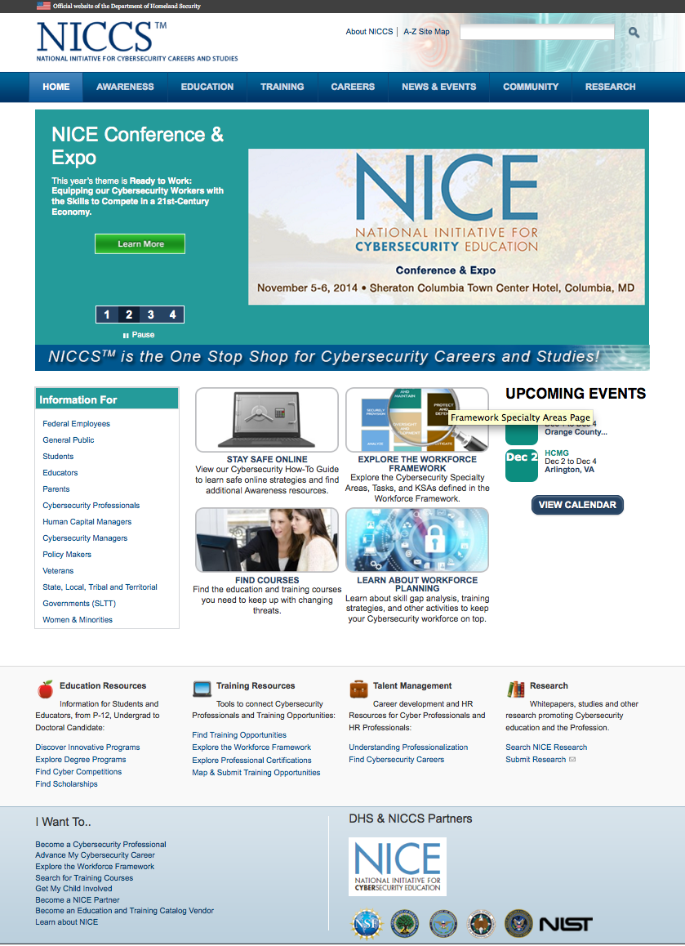
How You Can Use the Workforce Framework
Go to niccs.us-cert.gov
Download user guide
Download and use communications toolkit
Contact : NICCS@hq.dhs.gov
Notes:
To get started with using the Workforce Framework, visit NICCS.
Download a User Guide to take your first steps to align with the Workforce Framework.
Then, download the Communications Toolkit to help spread the word about the Workforce Framework, so others can also start aligning their workforces.
For further information or any questions, please contact us as NICCS@hq.dhs.gov.

