Slide 1
Information Security:
Still A Growth Career
Marc H. Noble, CISSP-ISSAP, CISM
Director of Government Affairs
(ISC)²
November, 2010

Slide 2
Outline
Discuss the evolution of IS/IA as a distinct career field
Review current status of IS/IA professionals in public and private Sectors
The (ISC)² Global Information Security Workforce Study—2008 and CISO Survey Reports 2009-10
Examine current educational and professional certification opportunities
Discuss current government programs

Slide 3
Growth of IS/IA as a Career Field
First dedicated IS/IA officers began to appear in the early 1970s.
National security community was leader
Civil agencies and private sector followed
Organizational placement/career advancement/recognition issues
Higher education recognizes need for dedicated IS/IA programs

Slide 4
Growth—Cont.
Slow growth in profession during 80s and 90s
Real surge began with the advent of internet as the basis for E-gov/E-commerce
Security problems create need for dedicated and qualified IT/IA security workforce
Need for qualified workforce stimulates the higher education community
Development of professional certifications for IT/IA security
DOD IT/IA workforce improvement program

Slide 5
The (ISC)² Global Information Security Workforce Study--2008
Respondents had:
  Responsibility for acquiring or managing their organizations’ information security
  Involvement in decision-making process regarding use of security technology and services and/or hiring of internal security staff
  Employment in the information security profession
Study objectives:
  Gain detailed insight into important trends and opportunities within the information security profession
  Provide you with information you can use to further your career, such as a clear understanding of pay scales, skills gaps, training requirements, corporate hiring practices, security budgets, career progression and corporate attitude toward information security

Slide 6
Highlights from 2008 Global Information Security Workforce Study
Conducted by Frost & Sullivan; sponsored by (ISC)²
1.66 million IS/IA professionals worldwide
Number will grow to 2.7 million by 2012
In North America the numbers are 749,470 going to 1,100,072 by 2012
Information technology, financial services, government, & professional services are largest employers

Slide 7
Highlights (North Amer) —Cont.
Level of Education—9% High School; 54% Bachelors; 31% Masters; 2% PhD
Years of Experience—45% 5 to 9 Years
Compensation—50% of respondents made $90K or more after five years of experience

Slide 8
Government CISO Survey 2009-10
Conducted by (ISC)2
CISO and Senior level information security
Trend in two years –
  Einstein, Web 2.0, policies in place, collaboration
  Enjoy position

Slide 9
Government CISO Survey 2009-10
Staffing plans for hires
  Contractor conversions (30.2 percent)
  Internally (29.8 percent)
  Private Sector (29 percent)
  Other agencies (21.3 percent)
  Scholarship for Service Program (20 percent)

Slide 10
IS/IA Security Has Many Facets
Chief Information Security Officers
Technical Specialists
Policy Wonks
Training Specialists
Intrusion Monitoring Specialists
Forensic Specialists
Evangelists
System/Network Security Administrators

Slide 11
Career LevevCareer Levels and Traditional Paths
Senior Executive
CIO; CISO; CTO; CRO; COOls and Traditional Paths
Senior Executive
CIO; CISO; CTO; CRO; COO
EXPERT
Principal Consultant;
Senior/Chief Architect;
Senior Security Auditor; Etc.
Specialist (Technical/Business)
Security Consultant; Security Designer/Architect; Security Auditor; Information Risk Consultant; Security Product Manager; Business Analyst
ENTRANT
Security Analyst; Security Developer; Security Administrator; Trainee Information Risk Consultant; Security Product Sales; Etc.
MANAGER/DIRECTOR
Consulting Manager/Director; Information Security Manager/Director; Head of Security Audit; Information Risk Manager/Director; Operations Manager/Director
Specialist (Management) Project Manager; Program Manager; Team Leader; Account Manager; Sales Manager; Marketing Manager
Years of experience & ability
Adapted from AINSER ISPR Framework

Slide 12
What is Happening in the Educational Environment?
Significant Growth of IS/IA Classes and Programs at Universities and Colleges
NSA/DHS Academic Centers of Excellence Program
Scholarship for Service Programs
Interesting Developments at the Community College Level
Need for Continuing Education

Slide 13
Rockefeller/Snowe Bill incorporated into Lieberman/Collins/Carper Bill
Introduced in April 2009—builds on existing program
Section 12 focuses on Federal Cyber Scholarship-for-Service Program
Scholarships for up to 1000 students/ year
Provides for summer and part-time employment for K-12 students
Authorizes $50M in FY-1010 going to $70M by FY 2014

Slide 14
Role of Professional Certifications
Growth in IA/IT Profession has been accompanied by growth of professional certifications
ISO 17024 adds value to certifications
Department of defense professional certification program
State department program
Growing reliance on certification as an employment criteria

Slide 15
The Future of the IS/IA Career Field
IS/IA career field has bright future
--Continued growth in integration of technology into all facets of life
--IT security concerns will not be solved in our lifetime
Career field is both wide and deep—plenty of opportunity for many participants

Slide 16
Advice to Interested Students
Don’t get involved in hacking
Keep a clean record—many IA/IS positions with government or government contractors require a security clearance
Opportunities to work in career field
--Internships
--Volunteer Positions

Slide 17
Advice—Cont.
Develop soft skills—IS/IA is not just about the technology.
--Ability to write clearly and speak effectively is very important
Understand the business impact of IT security

Slide 18
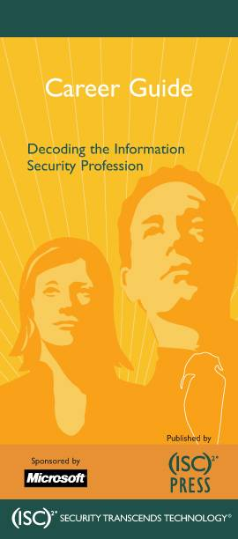
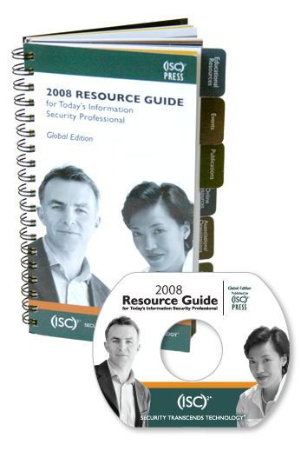
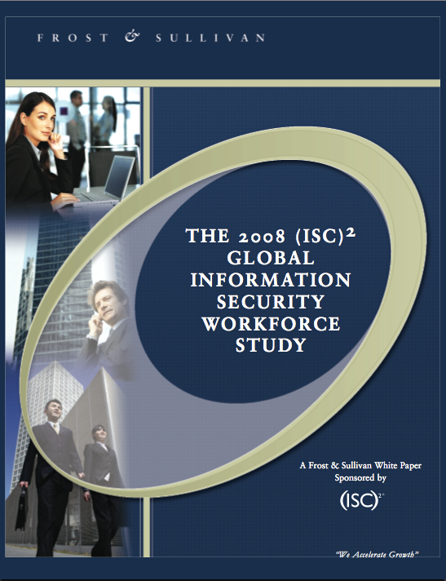

(ISC)² Publications of Interest
(ISC)² Resource Guide for Today’s Information Security Professional
  (ISC)² Hiring Guide to the Information Security Profession
  (ISC)² Career Guide: Decoding the Information Security Profession
  2008 Workforce Studies (Builds on previous reports)

Slide 19
Questions
Contact Information:
Marc Noble
Director of Government Affairs
(ISC)²
mnoble@isc2.org
703-399-4034

